Slide 1
On-Time Rate and Ticket Price Prediction for Commercial Flights
Guanyu Huang
Data Incubator Data Science Fellowship Application
July,2016

Slide 2

Expensive air tickets
loose some money
laughed by cheap ticket buyers
Delayed flights (even get cancelled)
miss our business meetings
miss our family moments
…
miss the one we love

Slide 3
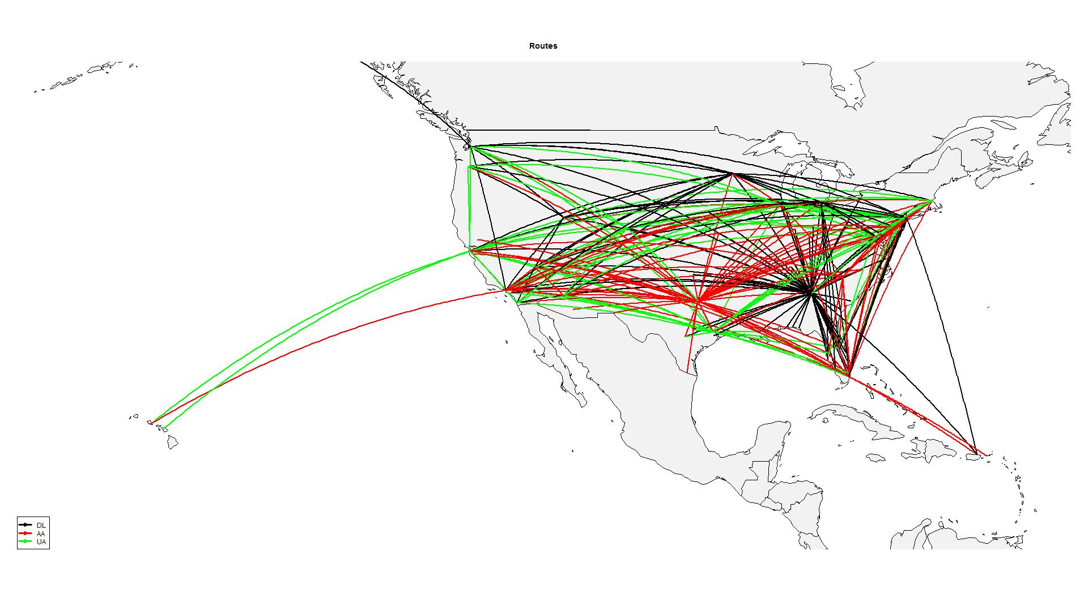
Making a choice is always hard
Which Airlines?
Non-stop or stop flights
If non-stop, which hub for layer-over
Which departure airports?
…
Will we be on time?
Busiest air routes by passenger number in U.S. by top three airlines (AA, DL and UA)

Slide 4
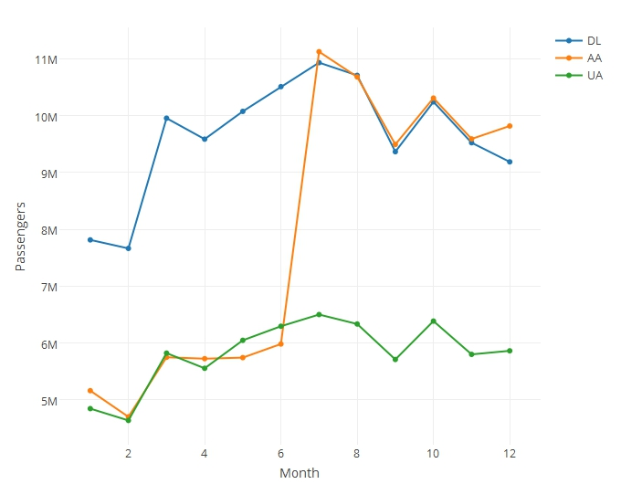
When to travel and when to buy?
We may always want to go vacation in summer, however, everyone thinks so
The earlier we buy, not necessary the cheaper our tickets
U.S. domestic monthly passengers by airlines, AA’s big jump in June is because AA and US’s merge.

Slide 5
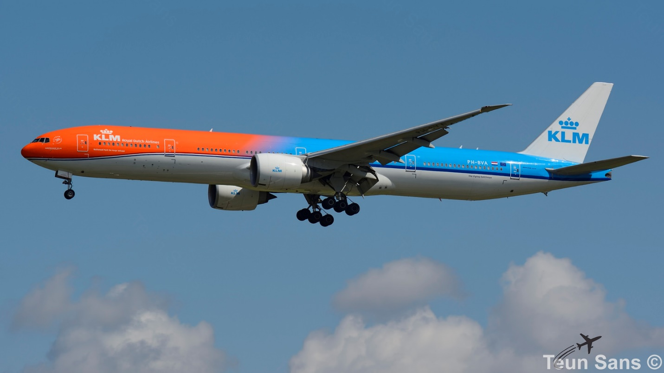
What we expect
Predict the cheap ticket price
Predict the on-time rate flights

Slide 6
Who will use it
Everyone, who travels by air
Travel agents
Large international companies
FAA
Airlines (maybe hate it)
…
Thank you
huangguanyu@gmail.com

